Slide 1
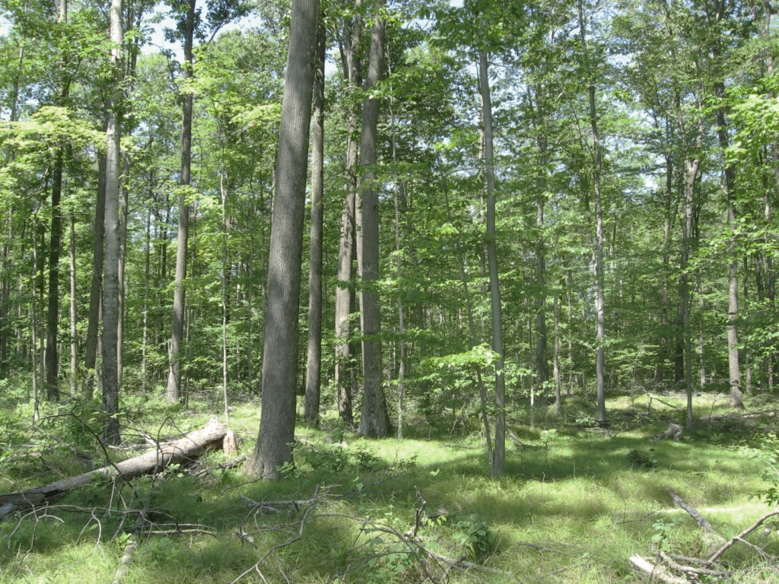
Wisconsin Private Forestry Advisory Committee
Recommendations for NIPF Landowner Engagement
Council on Forestry
March 28, 2018

Slide 2
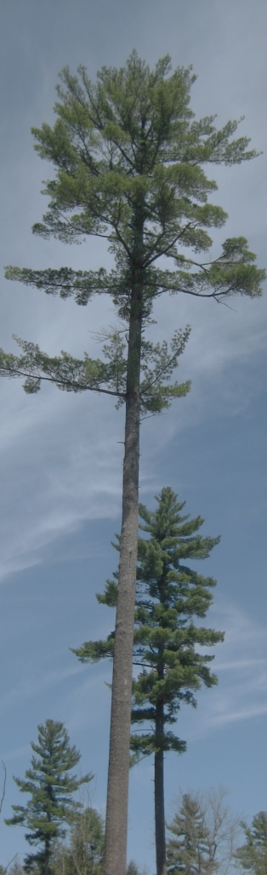
Opportunity
183,000 individuals & families own approx. 9 million acres of forestland (ownerships ≥10 acres)
Approx. 40,000 landowners in MFL
140,000 landowners of potential!

Slide 3
Importance
Family-owned private land supplies approximately 57% of the wood that Wisconsin’s forest products industry utilizes!

Slide 4
Wisconsin Private Forestry Advisory Committee (WFPAC)
Advises the Chief State Forester on:
Federal forest stewardship and legacy programs
Private woodland owner outreach and engagement
MFL and FCL
WI Forest Landowner Grant Program
Cooperating Forester Program
Certified Plan Writer Program
Forest certification
Forest health

Slide 5
WPFAC Membership
Co-chairs:
  Jim Warren (WDNR, Private Forestry)
  R.J. Wickham (WDNR, Forest Tax Law)
Landowner representatives:
  Nancy Bozek, Wisconsin Woodland Owners Association (NIPF)
  Shawn Hagan, The Forestland Group, LLC (industrial)
Consulting foresters:
  Bill Buckley, Wisconsin Consulting Foresters
Forest products industry:
  Aaron Burmeister, Timber Professionals Association
  Earl Gustafson, Wisconsin Paper Council

Slide 6
WPFAC Membership
Local government:
  Al Murray, Wisconsin Towns Association
Conservation organizations:
  Ann Calhoun, The Nature Conservancy
  David Solin, Wisconsin Land and Water Conservation Association
Wildlife:
  (Former) Scott Walter, Ruffed Grouse Society
Landowner cooperative:
  Joe Hovel, Partners in Forestry Cooperative
Public agencies:
  Andy Hart, Natural Resource Conservation Service
  Bill Klase, University of Wisconsin – Extension
  Dennis McDougall, United States Forest Service (State & Private Forestry)
  Brandon Soldner, Farm Services Agency

Slide 7
WPFAC Adhoc Team
UW-Extension
  Bill Klase, Ad-hoc Chairperson
  Darrell Zastrow
Aldo Leopold Foundation
  Buddy Huffaker
  Jen Simoni
  Steve Swenson
Ruffed Grouse Society
  Scott Walter
The Nature Conservancy
  Ann Calhoun
Wisconsin DNR
  Ron Gropp
  Kristin Lambert
Wisconsin Woodland Owners Association
  Carol Nielsen

Slide 8
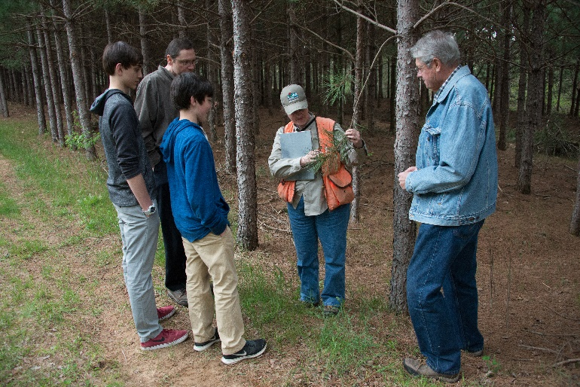
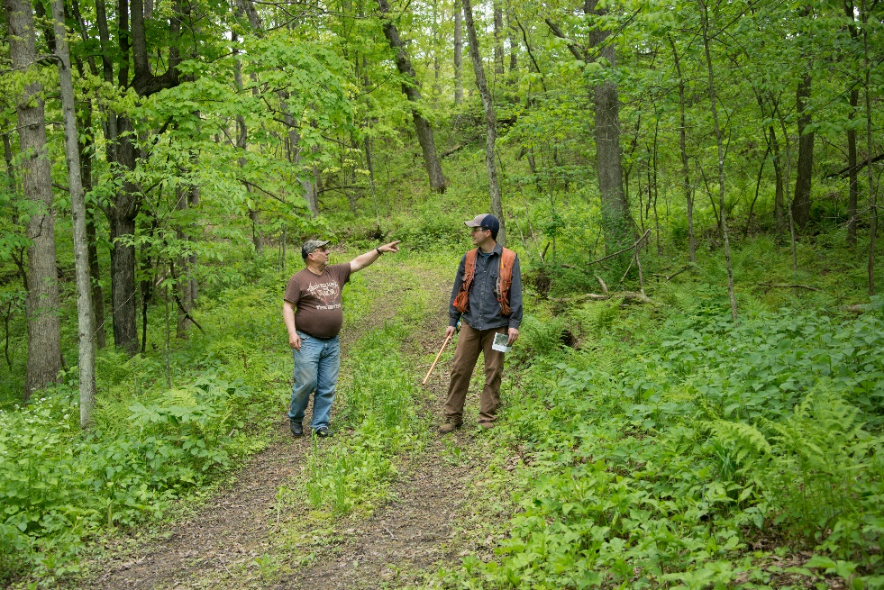
The Next Million Acres
Support the 5-year goal of connecting 20,000 new non-industrial private forest (NIPF) landowners with a resource professional to move 1,000,000 acres toward sustainable forestry in Wisconsin.

Slide 9
The Next Million Acres
Who | Annual Goal | 5-year Goal
DNR Foresters | 3,000 new NIPF Landowner visits w/50 acres avg. = 150,000 acres | 15,000 Landowner visits = 750,000 acres
Partners, consulting foresters, community engagement activities | 1,000 new NIPF Landowners w/50 acres avg = 50,000 acres | 5,000 Landowner visits = 250,000 acres
TOTAL | 4,000 new NIPF landowners = 200,000 acres | 20,000 new NIPF landowners = 1,000,000 acres

Slide 10

Public Agency Collaboration
Encourage Wisconsin Department of Natural Resources (WDNR) Division of Forestry and University of Wisconsin-Extension (UWEXT) to explore opportunities to align their public resources to achieve this goal.

Slide 11



Forestry Community Contribution
Encourage all stakeholders in the Wisconsin forestry community to adopt and embrace a landowner engagement model and strive to invest their unique resources and abilities towards this ambitious goal.

Slide 12
Notes:
Introduce disc diagram, fits some/all of the following bullets throughout
The model is built off an understanding and acknowledgement of behavior change science
We have moved beyond the information-deficit model to deliver in which people take action based on new information
Most people need additional steps beyond awareness to reach our desired action
Professional forestry community deserves credit for all the necessary work between awareness and significant action

Slide 13
Notes:
Laid our work against what we need to do to change landowner behavior
We have interventions that fills these needs, but how well are they connected in time and space?
Understand what our interventions are accomplishing
Better yet, how is one intervention connected to the next that intentionally moves that landowner closer to action
It does take time, so we need to be patient as landowners get comfortable making decisions
Not everyone is going to make it to the end, which is why we need to actively welcome more people into the funnel.

Slide 14
Notes:
How do we communicate about these various activities among the forestry community?
Identified Acquisition, Cultivation and Implementation, Evaluation and Tracking as the four major bodies of work.
Acquisition – who is actively pursuing new contacts?
Cultivation – who is providing on-going engagement that is foundational to action?
Technical expertise
Financial assistance for non-commercial practices in preparation for commercial practices
Implementation – how are we referring and preparing landowners to be successful with industry. Private sector consultants, loggers and industries are available and ready to assist with on the ground management and sustainable use of critical raw materials.
Evaluation and Tracking – Metrics, accountability, capture lessons learned, customer-driven
Forestry community begins to see how they are knitted together
Education and promotion - non-profits, associations,
Public sector – technical expertise, education, financial assistance can complete non-commercial work to prepare forests for commercial operations
Private industry – commercial activities
Openness to evaluation

Slide 15
Notes:
We further divided the major bodies of work into outcomes and strategies to make them more actionable.
Active pursuit – Identifying a target audience of unengaged woodland owners and seeking that audiences attention – that is a worthy outcome
They raised their hand – they just gave a permission to engage – they are receptive
In this work and pervious outreach trials DNR Division of Forestry identified gaps in their staff capacity – I give them credit for acknowledging the gap and filling it. Diane Anderson was recently hired as the Private Forestry Outreach Specialist for the Division.

Slide 16
DNR’s NIPF Landowner Education & Outreach Strategy
Outcome:
Strengthen Wisconsin’s forest economy thorough an active and integrated forest community focused on engaging private woodland owners.

Slide 17
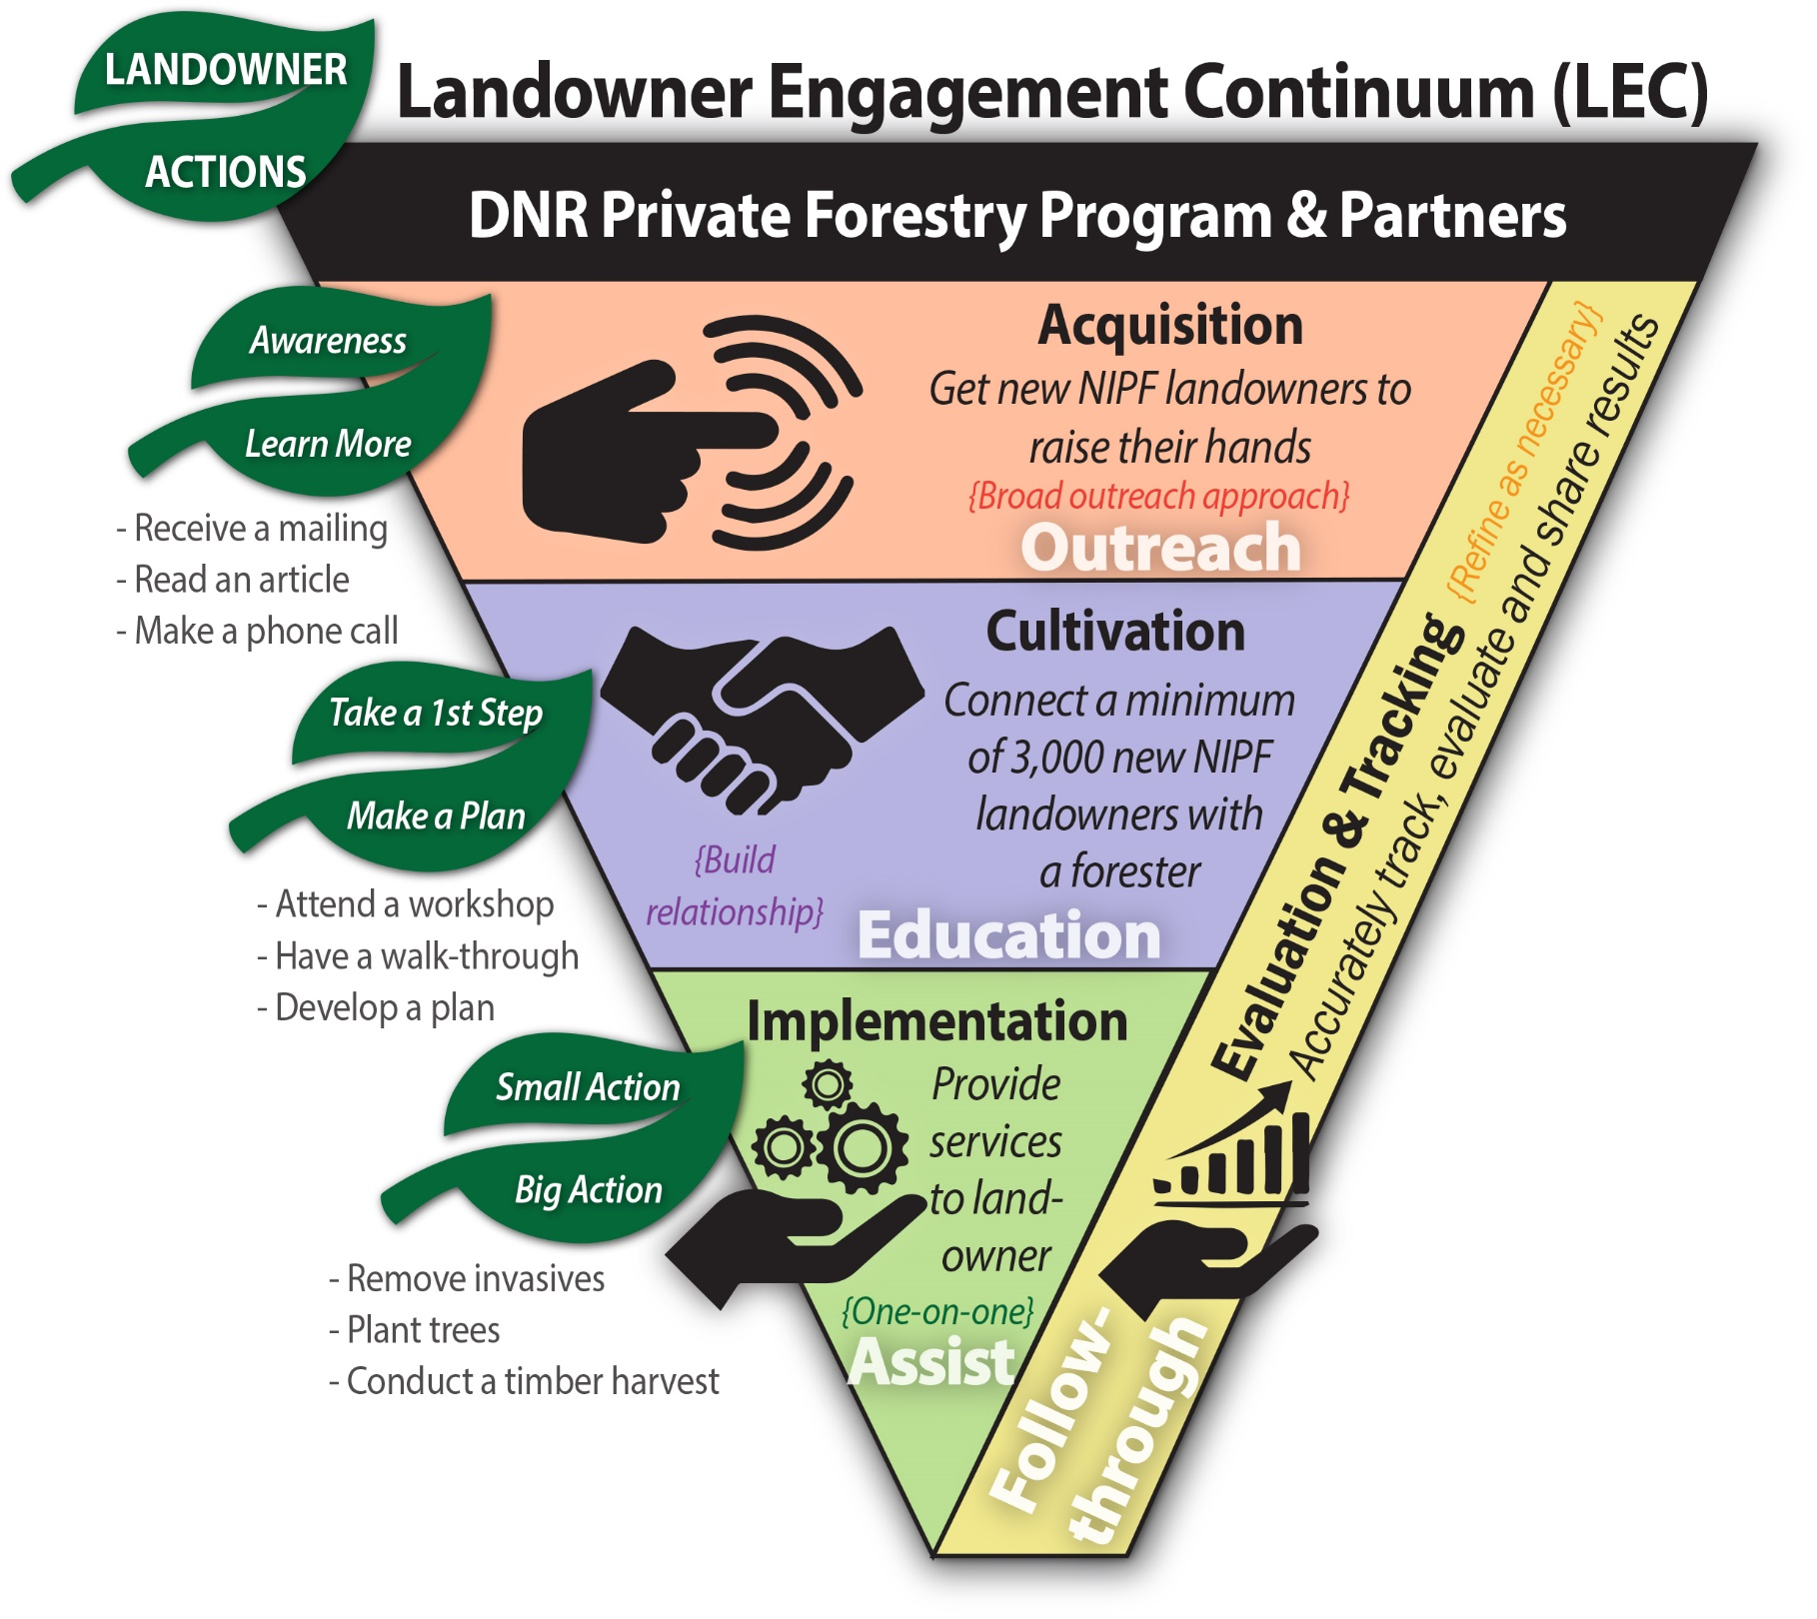
DNR’s NIPF Landowner Education & Outreach Strategy
Outcome:
Strengthen Wisconsin’s forest economy thorough an active and integrated forest community focused on engaging private woodland owners.

Slide 18
Growing Wisconsin’s ForesTREE Together
Several audiences working together:
Division of Forestry
  Took kit and training
Partners
  Expertise and resources
NIPF Landowners
  Private natural resources

Slide 19
New Outreach
Walk-through incentive
WoodsCamp in Wisconsin
WWOA radio and video spots
District In-Services
Advertising campaign
New communication materials

Slide 20
Thank you.
Questions?

